Slide 1
BETTER PLACES
GREATER IMPACT
STRONGER BUSINESS

Slide 2
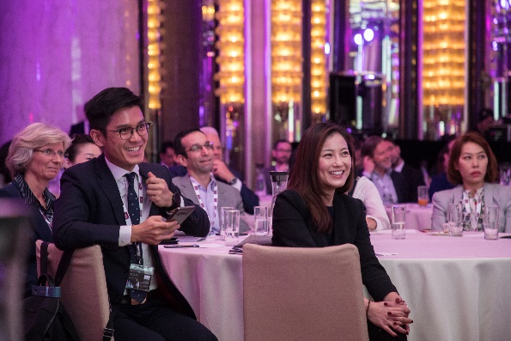
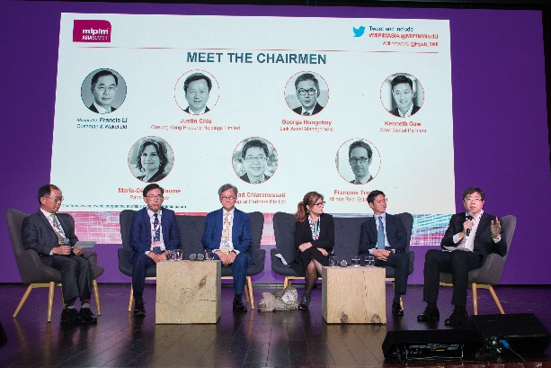
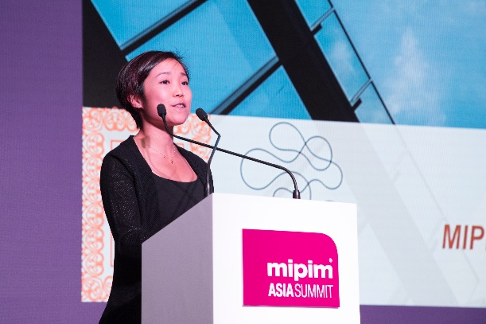
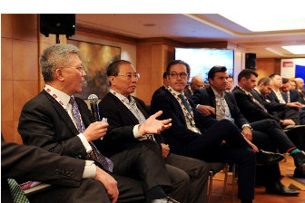
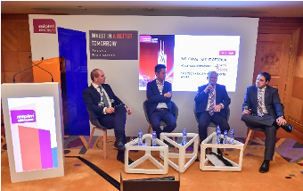
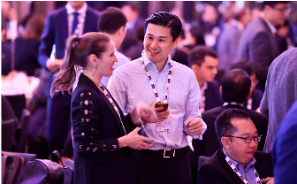
40+
SPEAKERS C-LEVEL
INSIGHTFUL
KEYNOTES, PANELS & INTERVIEWS
10+
CONFERENCES
LEARN, SHARE & NETWORK
INVESTORS
FORUM
MEET THE CHAIRMEN:
LEADERS PREDICT THE FUTURE OF REAL ESTATE
NETWORKING
MOMENTS

Slide 3
TUESDAY 6 DECEMBER |  | WEDNESDAY 7 DECEMBER
Grand Ballroom | Foyer | Grand Ballroom | Foyer
8.30 - 9.30 NETWORKING BREAKFAST
CONTENT NETWORKING
9.30 - 10.00 KEYNOTE – THE LEADERS’ PERSPECTIVE : WHERE DO WE GO FROM HERE ? PART II
10.00 - 10.45 REPOSITIONING ASSETS: HOW DO YOU REVITALIZE, RETROFIT OR REPURPOSE YOUR EXISTING PORTFOLIO?
10.00 – 12.00 INVESTORS FORUM
(Closed-door Investor Forum
by Invitation only) – Grand Room
10.45 - 11.15 COFFEE BREAK
11.15 - 12.00 INBOUND INVESTMENTS: WHAT’S HOT AND WHAT’S NOT?
11:30 REGISTRATION COUNTER OPENS
12.00 – 1.15 LUNCH
12.00 - 12.45 ALTERNATIVE INVESTMENTS: WHAT WILL EXCITE YOU NEXT?
12.45 - 2.00 NETWORKING LUNCH
1.30 - 2.00 KEYNOTE – THE LEADERS’ PERSPECTIVE : WHERE DO WE GO FROM HERE ? PART I
2.00-2.45 HONG KONG: REBUILDING ITS ASIA WORLD CITY’S REPUTATION
2.00 - 2.45 REALIZING NOT JUST THE ‘E’ BUT ‘S’ & ‘G’ IN ESG
2.45-3.30 CHINA: HOW BEST TO NAVIGATE THE REAL ESTATE INVESTMENT MARKET?
2.45 – 3.30 OUTBOUND INVESTMENTS: WHAT’S THE BEST BET?
3.30 - 4.00 COFFEE BREAK
3.30 - 4.00 COFFEE BREAK
4.00– 5.00 MEET THE CHAIRMEN: BETTER PLACES – GREATER IMPACT – STRONGER BUSINESS
4.00 - 4.45 INTEREST RATES AND CAPITAL RAISING: WHAT STRATEGIES COULD YOU EMPLOY?
4.45 – 5.30 BETTER PLACES: WORK, PLAY AND LIVE
6.00 REGISTRATION COUNTER OPENS
6.00-9.00 MIPIM ASIA 2022 AWARDS CEREMONY & GALA DINNER
KEYNOTE SPEECH BY RONNIE C CHAN, Chair of Hang Lung Properties Ltd.
(Separate Registration required)
5.30 – 6.30 OPENING DRINKS RECEPTION – Sponsored by

Slide 4
PROGRAMME 6 DECEMBER
2.45 – 3.30 OUTBOUND INVESTMENTS: WHAT’S THE BEST BET?
11.30 REGISTRATION COUNTER OPENS
12.00 – 1.15 LUNCH
What is happening in the major real estate markets outside of Asia? What asset classes are seeing capital from Asia, and who is investing and why? Is developed or developing real estate providing the best bets? What is the impact of the pandemic and global warming considerations on traditional and alternative investments? How much consideration should be given to ESG and new regulatory requirements? What examples are we seeing of governments working with investors to attract inward investments? Which ones are being particularly successful?
1.30 - 2.00 KEYNOTE – THE LEADERS’ PERSPECTIVE : WHERE DO WE GO FROM HERE ? PART I
2.00 - 2.45 REALIZING NOT JUST THE ‘E’ BUT ‘S’ & ‘G’ IN ESG
3.30 - 4.00 COFFEE BREAK
It is possibly fair to say that the Environmental aspect of ESG has had the most attention compared to the Social and Governance components. This session will try to balance the books somewhat by not just focusing on the challenges associated with integrating the ‘E’ of ESG into sustainable investment decision making but also the ‘S’ and ‘G’ elements and what the solutions are.
What impact could carbon accounting on green and brown assets have? What impact will Gen-Z have on sustainable ESG adoption with investors? What role should governments play in providing incentives and regulations? Turning to the social, what can be done to enhance societies? Does its importance vary between countries and regions? Moving to governance, what can be done to improve it? How can accountability and transparency be best maintained? How much of a focus is there on governance in terms of operational efficiencies and analyzing reputational concerns?
4.00 - 4.45 INTEREST RATES AND CAPITAL RAISING: WHAT STRATEGIES COULD YOU EMPLOY?
With interest rates continuing to increase rapidly, this session will explore the impact: how high could they go in Asia and beyond? What are the best ways for real estate to adapt in Asia and in other regions? What strategies could be used to raise capital? What effective best practice examples are we seeing today?
4.45 – 5.30 BETTER PLACES: WORK, PLAY AND LIVE
This session will discuss the latest trends, challenges and opportunities for hotels, coliving & coworking in Asia. In particular, it will debate innovative ways for hotels, coliving & coworking to be more agile and resilient, strategies to attract investment, and future demand levels and new consumer models. It will also evaluate the role they can increasingly play as an intrinsic part of the urban landscape
5.30 – 6.30 OPENING DRINKS RECEPTION – Sponsored by

Slide 5
PROGRAMME 7 DECEMBER
12.00 - 12.45 ALTERNATIVE INVESTMENTS: WHAT WILL EXCITE YOU NEXT?
8.30 - 9.30 NETWORKING BREAKFAST
Alternative markets can offer investors good returns but what are the hot new sectors and markets you should be focusing on now? From life sciences to data centres, from healthcare to logistics – and to something completely different…what could keep you awake with excitement next?
9.30 – 10.0 KEYNOTE – THE LEADERS’ PERSPECTIVE : WHERE DO WE GO FROM HERE? PART II
12.45 - 2.00 NETWORKING LUNCH
10.00 - 10.45 REPOSITIONING ASSETS: HOW DO YOU REVITALIZE, RETROFIT OR REPURPOSE YOUR EXISTING PORTFOLIO?
2.00-2.45 HONG KONG: REBUILDING ITS ASIA WORLD CITY’S REPUTATION
Offices are still the dominant segment among investor portfolios but what can be done to make them more attractive for employees and companies to return to post pandemic? Is it economic to retrofit stranded assets such as offices and retail outlets? Does the answer lie with government incentives and regulations only? Is it better to repurpose towards residential offerings or even healthcare, urban logistics, life sciences and leisure facilities? Where does the best return reside at?
Many investors have not visited Hong Kong for over two years with the strict social distancing measures in place. So what’s hot and what’s not now in Hong Kong? What markets should you avoid or embrace? What are the future projections for traditional and alternative asset classes? What does it all mean for real estate generally in Hong Kong? And what is the latest ESG and regulatory scene?
2.45-3.30 CHINA: HOW BEST TO NAVIGATE THE REAL ESTATE INVESTMENT MARKET?
10.45 – 11.15 COFFEE BREAK
11.15 – 12.00 INBOUND INVESTMENTS: WHAT’S HOT AND WHAT’S NOT?
How should you best navigate the real estate investment and development landscape in China? What markets should you be focusing on and avoiding? How are the established and emerging sectors fairing? A particular focus of discussion in this session will be on the housing crisis in China, exploring aspects such as distressed developers, fall of home sales, the liquidity squeeze and Chinese government policy.
For investors outside of Asia what should they be focusing on to diversify their portfolios? Should it be mainstream or alternative asset classes? Should it be emerging or developed countries or combination of both? What level of risk should they take? Is allocation to Asia Pacific increasing now that travel has resumed? And what should be done to attract investment to APAC?
3.30 - 4.00 COFFEE BREAK

Slide 6
PROGRAMME 7 DECEMBER
4.00– 5.00 MEET THE CHAIRMEN: BETTER PLACES – GREATER IMPACT – STRONGER BUSINESS
A traditional and unmissable closing session of the MIPIM Asia Summit. Each year, the industry’s most influential leaders share their thoughts on the real estate market and predict the future. It will also reveal how they are creating ‘Better Places’, achieving ‘Greater Impact’ and developing ‘Stronger Business’ – pathing the way for strong community cohesion, sustainable performance and long-term economic growth.
6.00 REGISTRATION COUNTER OPENS
6.00-9.00 MIPIM ASIA 2022 AWARDS CEREMONY & GALA DINNER
KEYNOTE SPEECH BY RONNIE C CHAN, Chair of Hang Lung Properties Ltd.
(Separate Registration required)

Slide 7
MIPIM ASIA WOULD LIKE TO THANK ALL OF ITS SPONSORS
PLATINIUM AWARDS SPONSOR
GOLD SPONSORS
SILVER SPONSORS

Slide 8
THANK YOU

